Slide 1
Real time sign language detection
Team Members :
Vansh Kumar Payala 22BAI1386
Garvit Agarwal 22BAI1288
Avi aaryan jeet 22BAI1380
Harsh singh 22bai1372

Slide 2
Problem statement
The project aims at basic sign language detection recordings to providing an instant access of hearing impaired people to communication process. The system will make use of the machine learning techniques and computer vision in order to enable its quick and correct recognition for numerous sign language gestures. The major goals tend to cover the areas consisting in an implementation of high-precision and strong-resilience to the natural lighting and diverse backgrounds as well as the topic of creating a library of sign language gestures and creating an interactive user interface which can be used both by non-users and sign language users. Through the creation with easy to use interaction between communities of different races and languages, the project aims to improve the accessibility of these languages and enrich the understanding and appreciation of people’s who are hearing impaired and use sign language as their primary medium of communication.

Slide 3
Literature review
1) The paper, which goes by the title "Real-Time Sign Language Detection Using CNN" is the research work done by four people namely Md Nafis Saiful, Mitul Das, Md Raisul Alam, and Ashifur Rahman. The paper describes a case of sign language real-time identification based on a Convolutional Neural Network (CNN) model. The system was tested using a dataset of sign language images, and the outcomes indicated that the system was successful in gesture detection in sign language with high accuracy within a real-time frame. The authors talked about the challenge of their proposed methods and how future studies can look at these challenges. The proposed approach carries with it a set of advantages such as the utilization of CNNs to generate automatic feature extraction and to do real-time detection of sign language gestures. The system’s easy-to-use interface renders it simple to be utilized by various groups.

Slide 4
Literature review
Nevertheless, along with the presented approaches, there are some limitations, for example, decreased accuracy in different lighting circumstances or when images are taken from different perspectives. Apart from this the system might also fail to recognize complex sign language gestures because the CNN model could only be trained with limited size of the data set. In addition to this, the system's real-time detection function could perform poorly on the old or less powerful equipment. To address these weaknesses future research should be aimed to improving CNN model ability to extract features from sign language images taken in different lighting conditions and looking from different directions. The improvement of the system which can recognize a more complex sign language can be achieved by including such a sign language gestures in the dataset. Bettering the system’s rate of work on older or less powerful devices may lead to more people using that system.

Slide 5
Literature review
2) The paper "Real-Time American Sign Language Recognition from Video Using Hidden Markov Models" by Thad Starner and Alex Pentland presents a real-time system which uses Hidden Markov models (HMMs) to recognize American Sign Language (ASL). The system uses a single color camera to record the hands in real-time and translates the ASL using HMMs. It reach 99.2% of word accuracy without the need for actually modelling the fingers. The system is built to recognize sentence-level ASL which is basically useful for signed conversations because it makes it possible for the discussion to proceed at the pace of spoken conversation. The authors then explain the system's architecture which is composed of a hand tracking module that captures coarse features such as hand shape, orientation, and trajectory, and a recognition stage that uses HMMs to decrypt the signed words.

Slide 6
Literature review
The specifications include the transmission of gestures without using the high-cost wired "datagloves". It is convenient for the user because a single gesture can represent a whole word instead of a finger one. On the other hand, the paper addresses enhancing the performance of such a system where the training set becomes more, as well context modeling is applied, thus an ASL recognition system that is not a person-dependent appears. It follows that this paper proposes a method, which is based on HMM, to build a real-time finger movement recognition system for ASL with a high accuracy and does not need to focus on the finger. The system is widely usable for everyday sentence-level recognition due to its design. It is based on virtual reality technology and accordingly does not need wired data-gloves. There is also a possible way that will ensure further advancement of the system by increasing the size of data training and the context modelling is also highlighted.

Slide 7
Literature review
3) Authors Tanmay Petkar, Tanay Patil, Ashwini Wadhankar, Vaishnavi Chandore, Vaishnavi Umate, and Dhanshri Hingnekar have conceived a real-time sign language recognition system which is useful for people with hearing and speech disabilities has in their paper "Real-Time Sign Language Recognition System for Hearing and Speech Imp The remedy is non-discriminatory, and is using voice to text AI functionality that allows people to communicate without any discrimination. The system methodology is based on generating dataset via OpenCV library software followed by forming a gestures dictionary of sign language. Main part of the system is to recognize fast sign language, and this require the use of image processing and machine learning techniques. The function of this system is to detect those hand movements (gestures and signs) which sign lanuage uses and implement them as the text/ voice output.

Slide 8
Literature review
The aim of that system is to advance artificial intelligence, which allow to human- computer interfaces and sign language. This system provides us with an economical advantage because it is not geared towards the deaf community specifically, nor the hearing-impaired, but instead it targets all who might face communication difficulties. The integration of the language recognition via written word represents the helplessness of the hearing system that is blurred by the declining deaf system. Such stage consisting of processing the images and machine learning algorithms technologies has great potential for faster research and development of the sign language recognition and the normal human speech creation. Fundamentally, it proposes how an actual sign language recognition system for the people who are having trouble in hearing and speech can be created linking it with vision-grounded approach along with imagery processing technologies and machine learning algorithms for the identification and generation of the sign language model. As an upshot, this system can be proved to make a difference in the Deaf and hearing communities where they can now communicate with each other better.

Slide 9
Literature review
4) The paper "Machine learning methods for sign language recognition: A Critical Review and Analysis" written by I. A. Adeyanju, O. O. Bello, and M. A. Adegboye delves into the research reports on intelligent systems in sign language for the time span of two decades. The purpose of the research is the formulation of advanced ASLR smart systems, imbued with intelligent solutions which are designed to address multi-variant contemporary sign languages. The paper surveys different mechanisms for involuntary sign language recognition, explains the feature extractions and classifications techniques used in sign language recognition as well as focuses on smart solution application in the area.

Slide 10
Literature review
In addition to that, the article will shed a light on the machine learning techniques which are used for sign language recognition comprising K-Nearest Neighbour algorithm (K-NN), Deep Neural Network (ANN), SVM, HMM, Convolutional Neural Network (CNN), fuzzy logic, and ensemble machine learning. In addition, it has details on the terminal datasets that hold sign language in different countries, manifesting the diversity of types of data that can be used in training and testing sign language recognition systems. As a whole, the article is worthy for the scholarly workers and practitioners in sign language recognition, providing evidence based practice and defining the relevance of intelligent solutions in developing the best way to recognize sign languages.

Slide 11
Literature review
5) The article 'Real-time American Sign Language Recognition Using Wrist-worn Motion and Surface EMG Sensors' by Jian Wu, Zhongjun Tian, Lu Sun, Leonardo Estevez, and Roozbeh Jafari introduces a system that captures both motion data from inertial sensors and electrical muscle data (EMG) from surface sensors in order to let computers understand The smart sensing device utilizes an adaptive automatic segmentation method for sEMG to separate the beginning and the end of a sign achieving a more accurate recognition of sign language. With the integration of data from IMU sensors worn on the wrist and sEMG sensors, the system is capable of capturing hand orientations, hand and arm movements, hand shapes as well as finger movements, which enables accurate recognition of the large amount of signs used in "real time" communication.

Slide 12
Literature review
Besides, the adopted sensors of IMU and sEMG, the proposed system does such a recognition free of expensive devices such as glove, and this helps to use it practically every day. The mechanism is successful in its understanding of the various ASL gestures including palm placements, movements, shapes, and finger movement which shows its “one-stop shop” approach of ASL recognition. Finally, the paper postulates that a novel real-time ASL recognition structure is shown, which uses wearable motion and surface EMG sensors to distinguish sign language gestures more precisely than in-home gadgets, chatting in sign language, and bi-lingual communication systems, does provide a potential solution that can increase communication for the hard of hearing.

Slide 13
Dataset
In our Sign Language Detection project, we worked out a very thorough process of manual data collection, which was a basis for training machine learning models. This dataset assembles various sign language gestures from a large collection of carefully produced video depicted sign language gestures going by the hand movements, finger spelling etc. Each gesture was extensively labeled and annotated for precise training and validation. The profiled comprehensive dataset will be used by us to bring a highly accurate and robust sign language detection system that can be integrated with a real-time interpretation. Also, the dataset forms a helpful tool for the current and future research into the sign language communication technologies with the end goal of creating more inclusive and accessible world for a hearing impaired people.

Slide 14
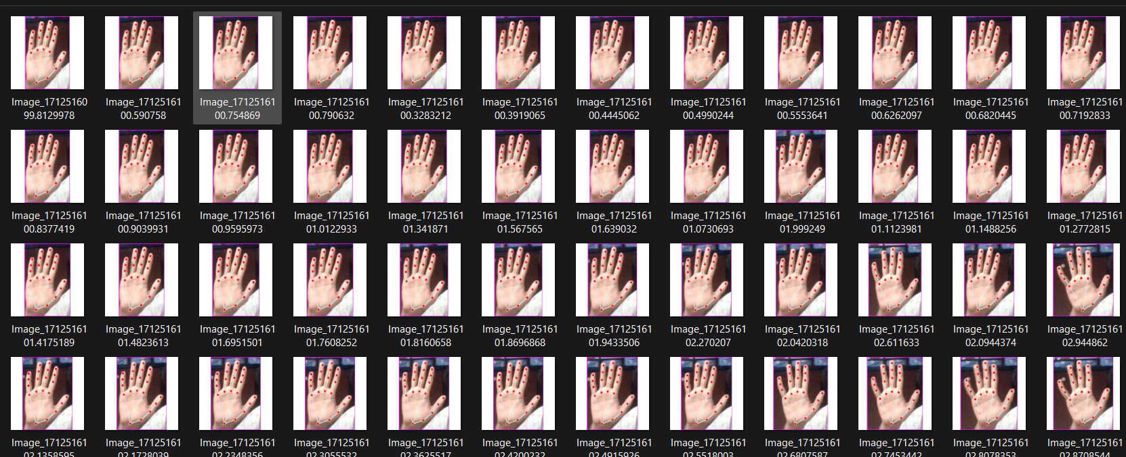
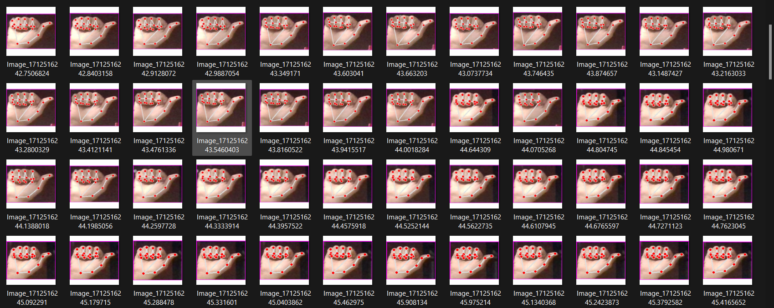
Dataset

Slide 15
Methodology
The procedure begins with a camera signer recording live gestures, then getting converted into images via the Image Acquisition phase, resulting in visual inputs for the next stage (i.e. processing). Applying this next, Hand Detection and Tracking algorithm marks out and isolate hand motions within the images so that the sign language information can be interpreted effectively. Following, the Feature Extraction occurs which is aimed at discovering the slightest details of the movements as well as patterns to derive the features based on which recognition will be made. The preprocessing operations follow these steps for the preparation of extracted features will go to the Recognition module. Techniques including data normalization and limiting dimensions in practical applications help model to get more efficient input.

Slide 16
Methodology
The Recognition module, being the key part of the learning system, uses a trained CNN with pre-processed features as inputs. It matches the obtained results with sign language vocabulary which is stored in the Training Database. Joining these files together results in a generalized database where the examples used for training the CNN are labeled. Further, the awarded sign language words are demonstrated in the form of sign example, usually shown as text thus facilitating access to information to non-sign language users. We have successfully implemented the adaptive algorithm that integrates feature extraction, computer vision, CNN-based machine learning, and pattern recognition techniques, and achieves the automatic recognition and transcription of the sign language that largely increases the accessibility and inclusivity.

Slide 17
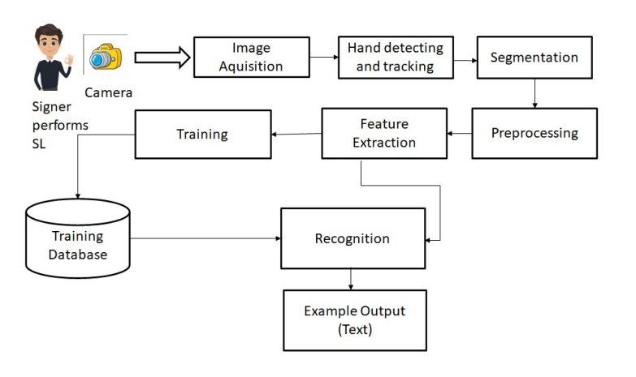
Block Diagram

Slide 18
Reason for methodology
Methodology of sign language detection with the aid of Convolutional Neural Networks (CNNs) contains several promising advantages. In the first place, CNNs are an apt architectures for finding hierarchical features in raw data. They can thus also be utilized for processing image-based inputs such as sign language gestures that are captured by cameras. Their ability to automatically extract the meaningful features from images automates the process of identifying and capturing hand movements, which in turn making the sign language recognition system more precise and faster. Additionally, CNNs are very adaptate and can be trained on large dataset which allows for a deep learning of different vocabularies of the sign language. Scalability of CNN-based systems is also an advantage because they can support the real-time processing. Real-time communication becomes easier between the signers and non-signers in different situations. Additionally, the multiple of deep learning frameworks and platforms makes it easy for researchers to design and implement CNN-based sign language detection systems which are readily accessible for various researches, developments and implementations needed to support deaf and hard-of-hearing communities.

Slide 19
Hyperparameters
Kernel Size: Forms the size of the filter that is applied in convolutional layers, consequently deciding the covering factor and the feature extraction level.
Number of Filters: Determines the sizes of feature maps produced in convolutional filters and thusability of the model to capture different features is resolved by it.
Pooling Size: Says that number of downsampling stages in pooling layers is regulated being the means to get smaller spatial dimensions and to reduce computational complexity and overfitting prevention.
Dropout Rate: Decides on how many neuron will drop out during training process, functions as regularizer which prevents the model from overfitting and leads to generalization.
Learning Rate: It dictates the step size in experiments using gradient descent optimization or the process of balancing stability and model performance.
Batch Size: Represents the extent to which the model can learn from different samples in each training cycle, having stability as a consideration, memory usage, and computational efficiency in mind.
Number of Epochs: By the way, one step means that the model goes through the whole dataset once, training over different iterations and variants, discovering which ones give the best result and anyway is a huge aid to the convergence and generalization of the model.

Slide 20
Code
Github Link - https://github.com/Vansh-payala/Sign-Language-Detection

Slide 21
Improvements in Task Associated Metrics
Among the outcome metrics, the present incarnation of the sign language recognition machine is amazingly precise. For the 5 letters (A, M, N, S and T) that have been tested so far, the system has a nearly 100% (could be 99 or 98) accuracy rate in correctly choosing the right hand motion. The predictor is therefore a good model, because the used machine learning model as well as the preprocessing techniques are capturing the necessary features of the sign language alphabets. Yet, coverage of numerous alphabets as well as hand signals can be a good development which makes the entire system more efficient and robust. Synthesizing gestures and various environmental nuances to be recognized results in more significant difficulty achieving a high precision rate. A possible way to increase the accuracy and F1-Score of the model is to have a better and more diverse training set with more of the sign language alphabet and gestures from around the world. Thus, the machine learning model will be able to pick up the slight variations and stylistic excreta, in hand shapes and moves hence it will be better at differentiating them. The sign language detection system can constantly be improved by refining the dataset, exploring even more complex machine learning methods, and using a robust data preprocessing and augmentation techniques. In that way, it will be possible to achieve results with higher accuracy and F1-scores, thus providing a better experience to the deaf and hard of hearing community.

Slide 22
Novelty Aspects
The methodology used for this project of Sign language detection can be upgraded by utilizing a set of procedures put forward to substantially expand the detection of accuracy, stability, and user-friendliness.
Adaptive Learning Strategies: Encompassing adaptive learning methods that can make model modifications based on the complexity of the data or user's proficiency level. The use of adaptive strategies will enable individuals to personalize their learning in the way that is most suitable to them resulting in a more friendly and precise system to those who have different sign language proficiency levels.
Real-time Feedback Mechanisms: Have in-built feedback mechanisms that the user is provided with immediate feedback on the accuracy of the detected gestures. The feedback mechanisms may provide users with the opportunity to sharpen their signing gestures in the process. It, therefore, encourages learning as well as increases communication conciseness.

Slide 23
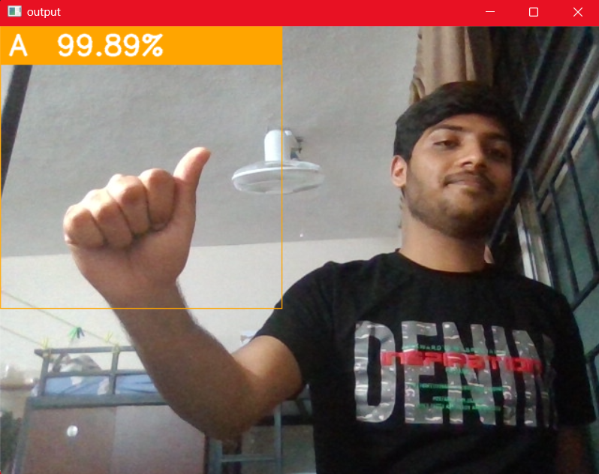
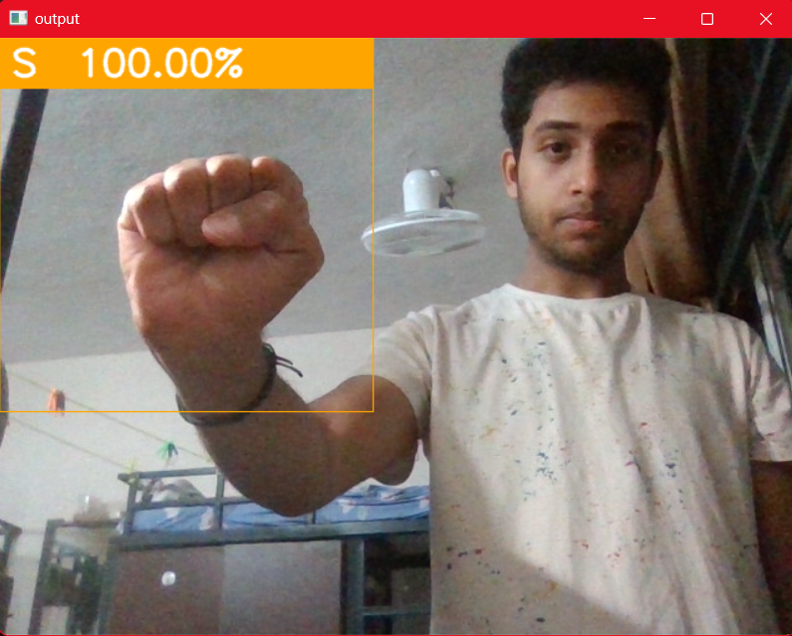
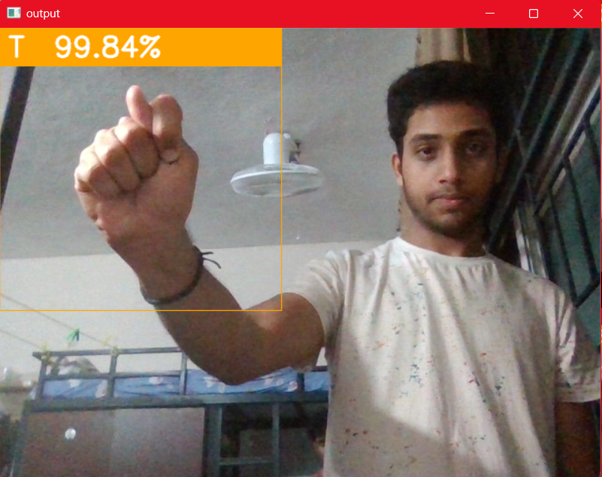
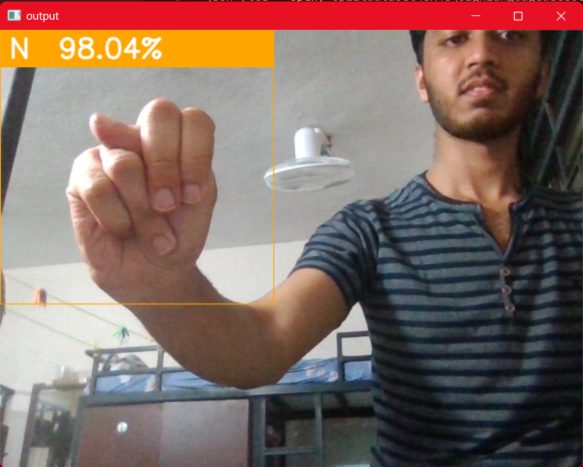
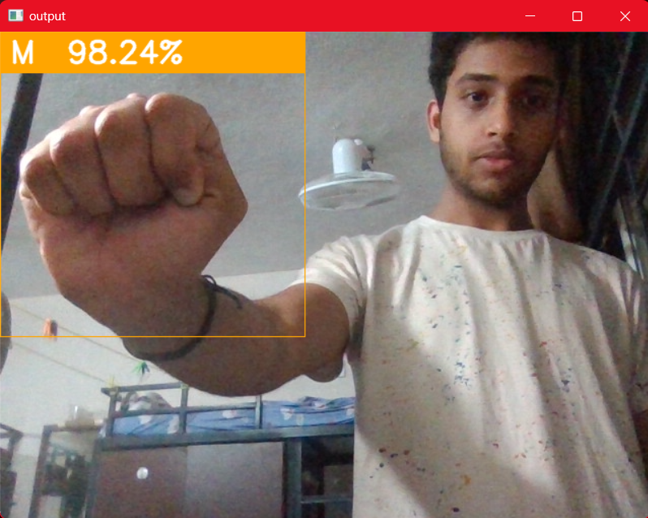
Results

Slide 24
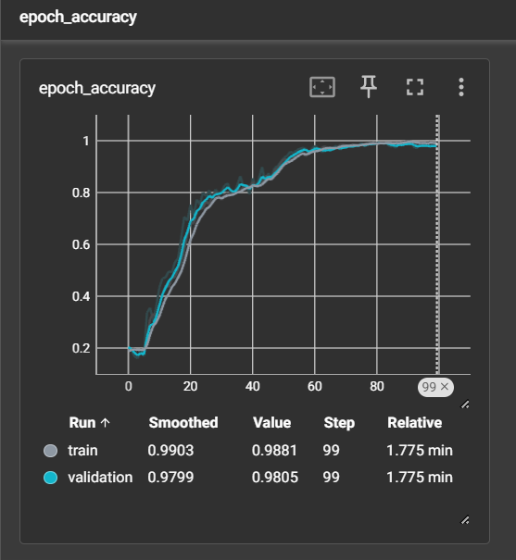
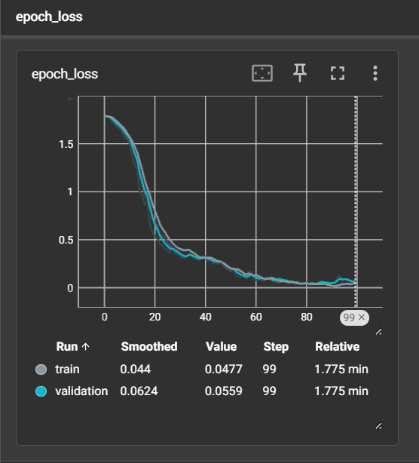
Results

Slide 25
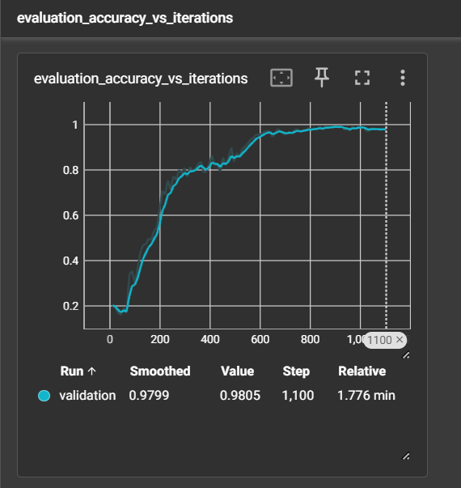
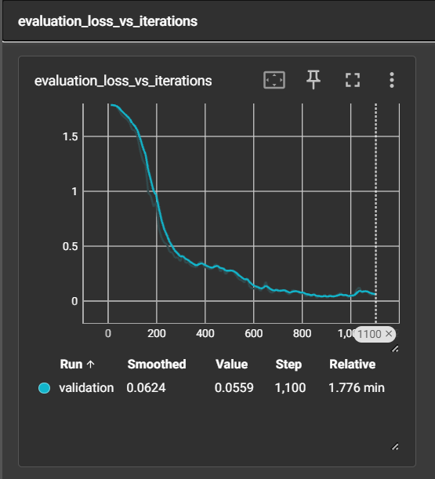
Results

Slide 26
Future plan
Moving forth, this project platforms will be expanded to accommodate all 26 scripts of the English language as well as sign languages other than American Sign Language (ASL), British Sign Language (ASL) and many others. Further improvement on models capability to identify and pick sign language gestures from faraway places will be given a priority and it could possibly be carried out through the use of fancier computer vision techniques that include depth sensingData augmentation will be used to improve the data with respect to lighting variations, hand orientations and backgrounds. This supports the model to be robust and able to conceptualize during different scenarios with sureness.Besides this, optimizations for speed and efficiency are going to be made to stand in for real-time performance and also enhancing user interface that helps in communication interaction between sign language users and non-signers.In addition to mobile and embedded devices deployment which is the emphasis of wide accessibility, feedback mechanisms will be integrated to the model as part of continuous refinement, and the improvement of accuracy and user satisfaction over time.Through these endeavors, the project aims to evolve into a comprehensive and versatile sign language detection and recognition system that enhances accessibility and inclusivity across various languages and environments.

Slide 27
Thank you

